Slide 1
Basin Selection 2021
October 2020

Slide 2
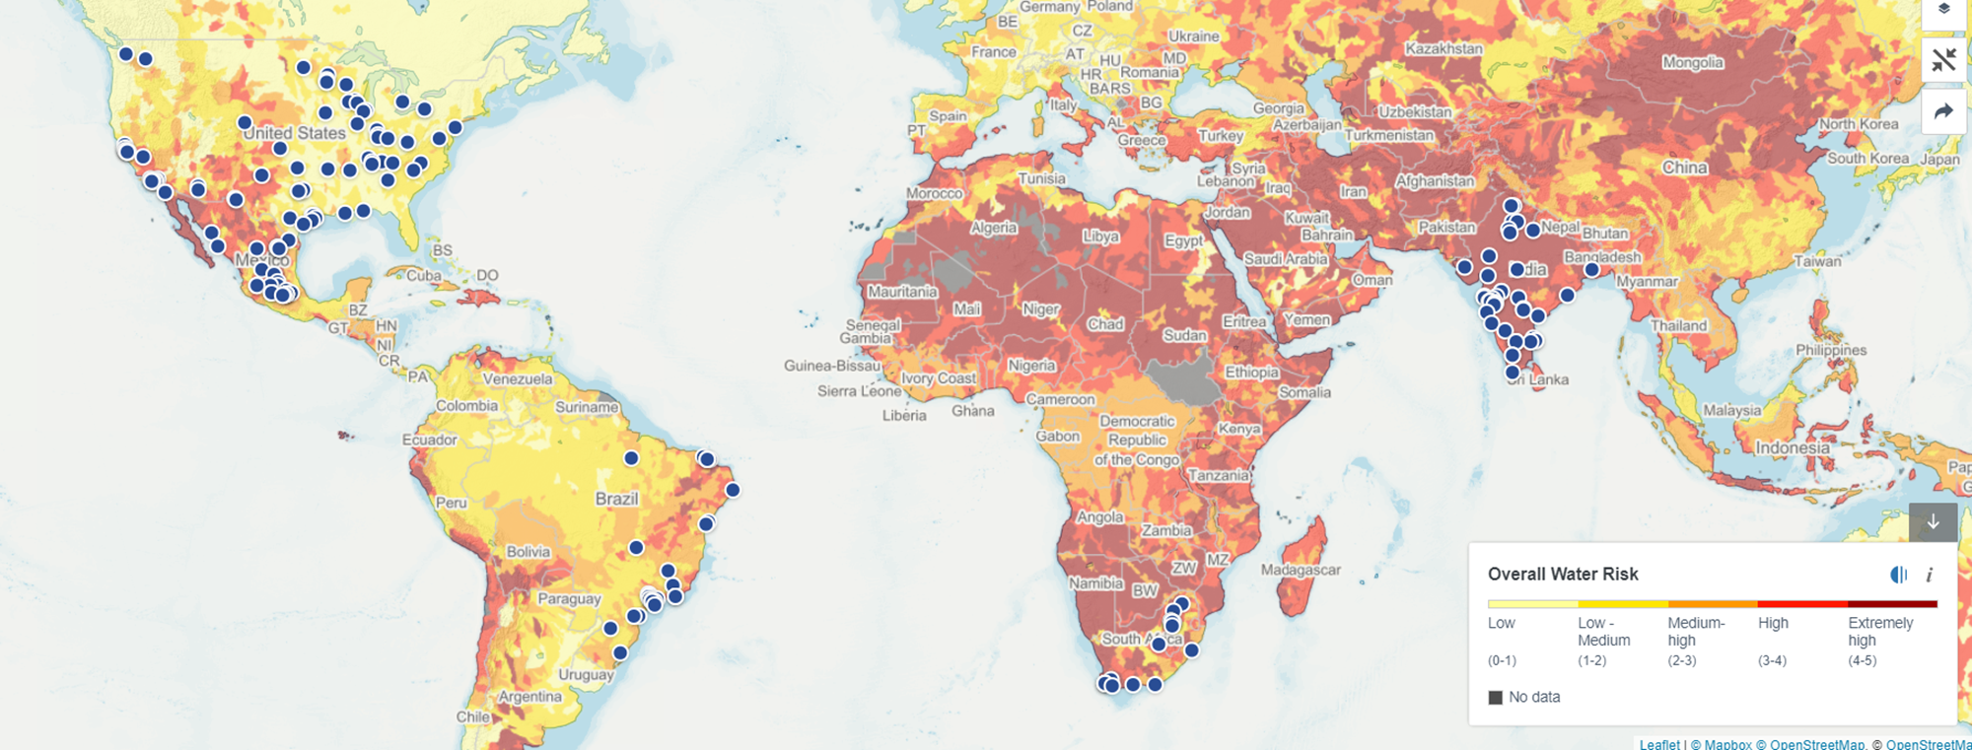
2020 BASIN SELECTION – MEMBER CLUSTERS
Notes:
Hannah
Map of all company locations received to date

Slide 3
2020 BASIN SELECTION LEADING CONTENDERS (MEMBERS + STRESS)
Brazil
PCJ (São Paulo)
USA
California - San Francisco
South Africa
Mexico
India
Integrated Vaal River System (Gauteng)
Santiago Guadalajara (Queretaro)
Cauvery (Coimbatore + Bangalore)
Mississippi (Entire Basin)
California – Los Angeles
Choro (Ceará)
South Atlantic Coast (Rio de Janeiro)
Berg – Breede (Cape Town)
Limpopo (Limpopo 3)
Bravo / San Juan (Monterrey +)
Moctezuma (Mexico City)
Krishna (Mumbai – Pune)
Ganges (Yamuna) (New Delhi +)
Notes:
Andre
Leading contenders is a summary of the top basins
For our next meeting, we will refine the analysis based on the feedback and divide this list into two groups- priority, lower priority
The priority basins will be filtered using the minimum requirements

Slide 4
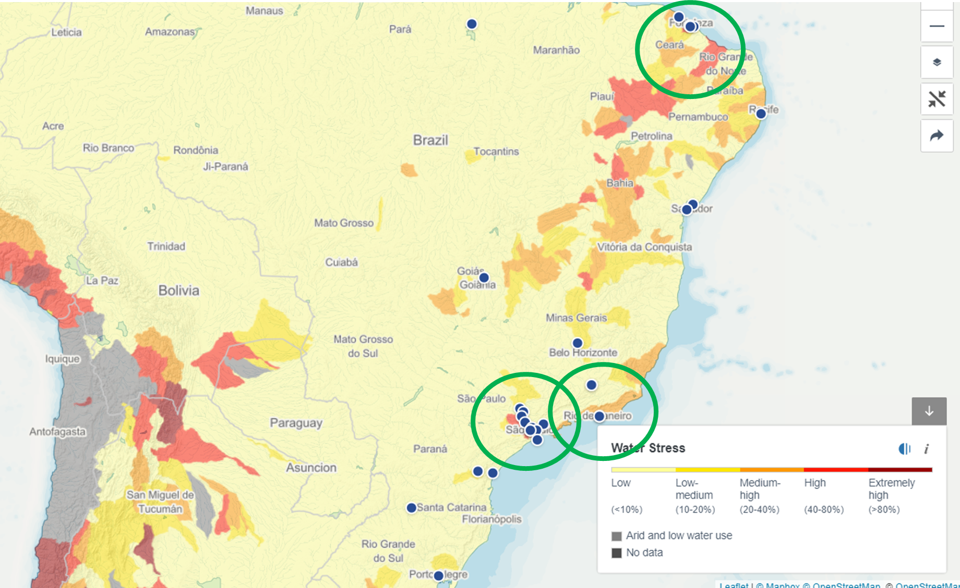
2020 BASIN SELECTION – RESULTS FOR BRAZIL
Ceará (Choro)
Rio de Janeiro
Sao Paulo (PCJ)
Notes:
Hannah
The top basins and company locations are shown on this map

Slide 5
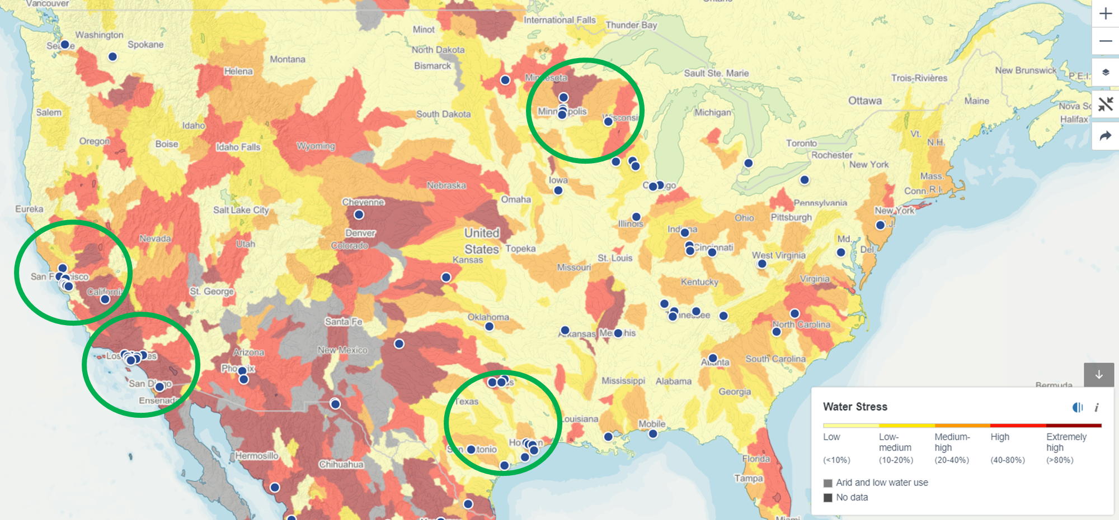
2020 BASIN SELECTION – RESULTS FOR THE USA
Upper Mississippi
California – San Francisco
Entire Mississippi
California – Los Angeles
Gulf Coast

Slide 6
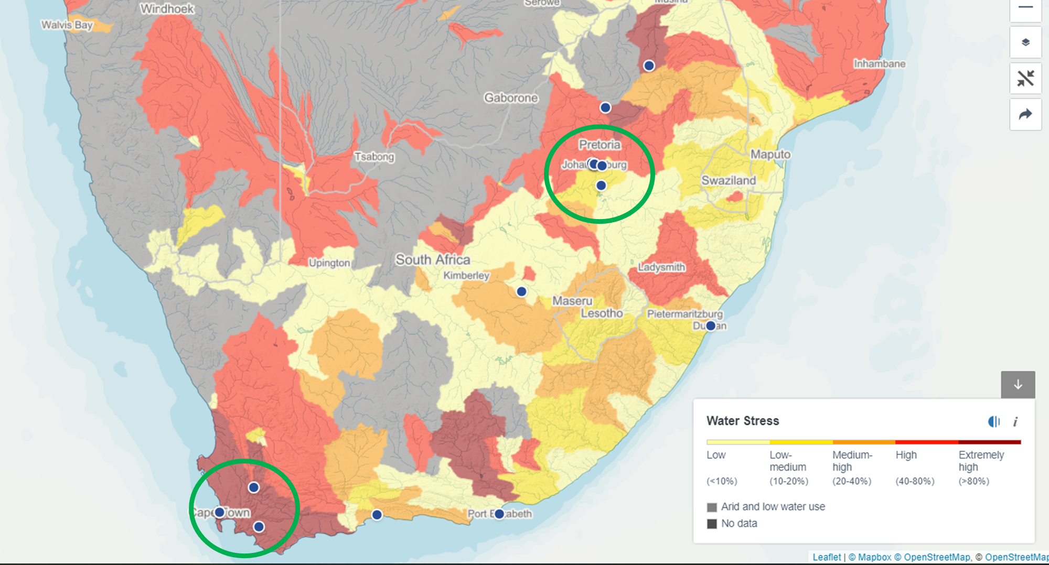
2020 BASIN SELECTION – RESULTS FOR SOUTH AFRICA
Limpopo (Limpopo 3)
Integrated Vaal River System (Gauteng)
Berg – Breede (Cape Town)
Notes:
Hannah
Top basins are XX

Slide 7
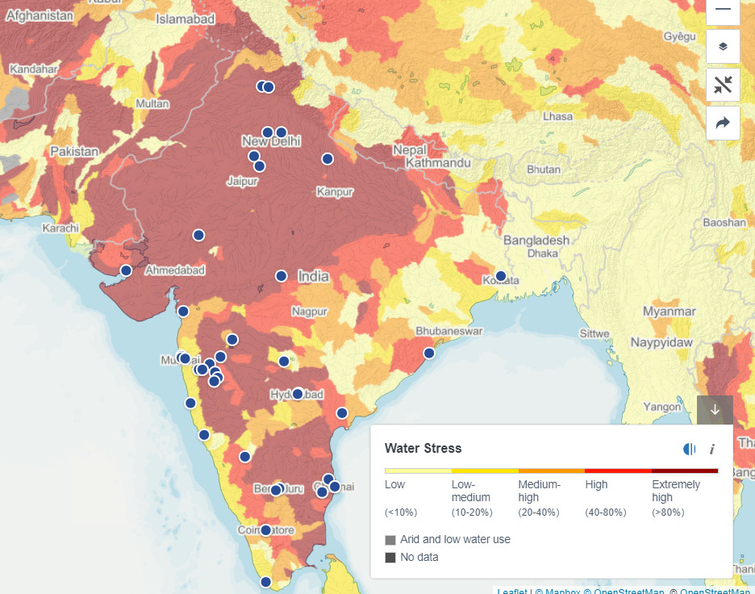
2020 BASIN SELECTION – RESULTS FOR INDIA
Ganga (Yamuna) (New Delhi +)
Krishna (Mumbai – Pune)
Cauvery (Coimbatore + Bangalore)

Slide 8
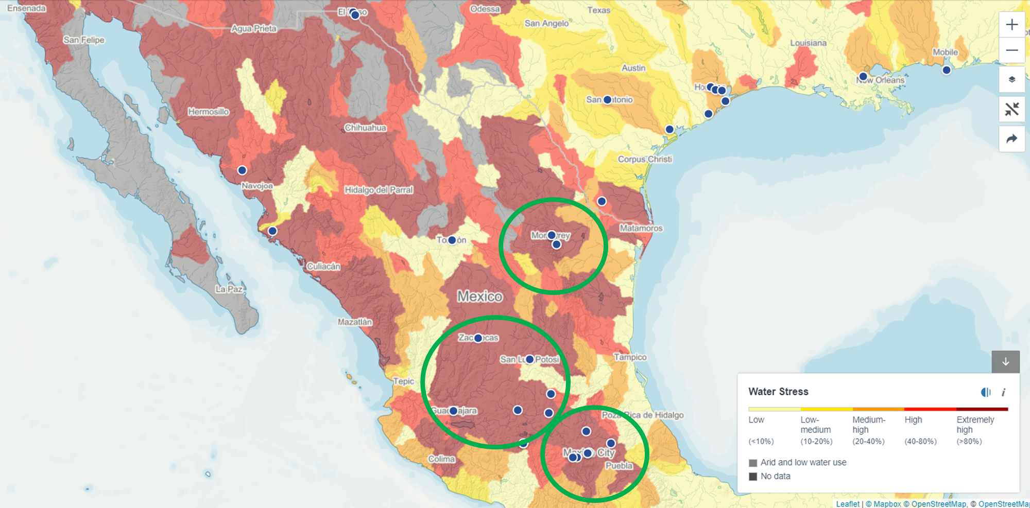
2020 BASIN SELECTION – RESULTS FOR MEXICO
Bravo / San Juan (Monterrey +)
Santiago Guadalajara (Queretaro)
Moctezuma (Mexico City)

Slide 9
Thank you!
André Ramalho
Pacific Institute / CEO Water Mandate
avramalho@pacinst.org

