Slide 1



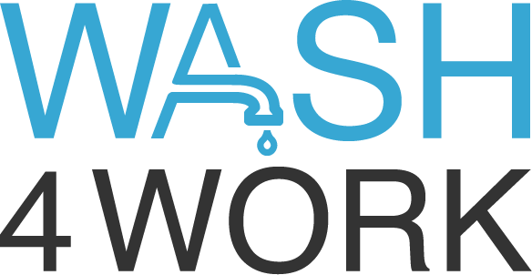

2022
Notes:
WASH4Work was launched on World Water Day 2016 with UNICEF as the champion of the initiative,
The goal of the initiative is to mobilize businesses to improve access to water, sanitation, and hygiene (WASH) in the workplace, across supply chains, and in the communities where workers live.
The initiative brings together businesses committing to WASH as a priority in corporate water stewardship with WASH expert stakeholders to advance business actions on WASH and to share leading practice to encourage more businesses to take action on WASH

Slide 2

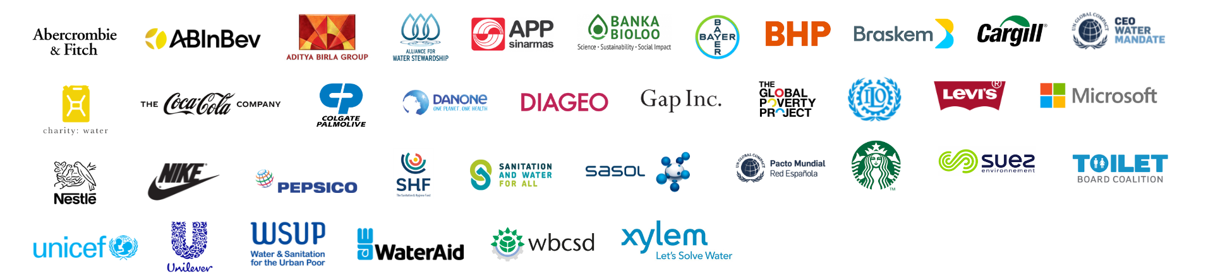
  WASH4Work is mobilizing business action on water, sanitation and hygiene (WASH) ​
  in workplace operations,
  in communities where companies operate,
  and across supply chains. ​
wash4work.org
Notes:
WASH4Work was launched on World Water Day 2016 with UNICEF as the champion of the initiative,
The goal of the initiative is to mobilize businesses to improve access to water, sanitation, and hygiene (WASH) in the workplace, across supply chains, and in the communities where workers live.
The initiative brings together businesses committing to WASH as a priority in corporate water stewardship with WASH expert stakeholders to advance business actions on WASH and to share leading practice to encourage more businesses to take action on WASH

Slide 3
Water, Sanitation & Hygiene Access (WASH) is material to business productivity, continuity, reputation and trust
Over 4.5 billion people do not have access to safely managed water supply, sanitation and waste management
In 2022, 2.3 billion people do not have access to basic WASH
Safe WASH at work and at home directly affects worker health and safety, productivity and security of business-critical raw materials
Lack of access to WASH in communities where businesses operate and withdraw water, directly affects reputation, trust and license to operate

Slide 4
Water, Sanitation & Hygiene Access (WASH) creates business value, and climate and water resilience
Access to WASH builds people’s resilience to climate change
via water security and capacity to manage water-related risks
Universal WASH access will unlock trillions of dollars in value over the next 2 decades
Financial ROI of investing in WASH has been proven via productivity gains, avoided health costs, and contributions to shareholder value.
Price of WASH risk
calculated at
$6 Billion amongst just
10 global companies

Slide 5
Water, Sanitation & Hygiene Access (WASH)
A key pillar of Corporate Water Stewardship
WATER QUANTITY
WATER QUALITY
WASH ACESS
Notes:
Review of Member Reporting
to identify a common set of WASH indicators
Summary of Findings:
- 2/3 of W4W Members have /are reporting publicly on their WASH actions – which is a high average when compared to broader corporate water stewardship leaders
- Minority of W4W Members have reported public targets for WASH
- WASH actions reported focus primarily on access to safe water in communities, with only a minority reporting on access to sanitation and hygiene
- Majority of reporting on water stewardship is focused on water quality and quantity often excluding WASH
- A diverse set of benefits and outcomes of WASH actions were cited, however we found no obvious common / cross-cutting indicators reported by all
- We found no references to climate-resilient WASH, however community resilience was cited
------------------
Engagement Webinar with WASH Pledge Signatories
to identify WASH implementation stage & support needs
Summary of Findings:
- About 75 companies joined 2 webinars in March, majority of participants were SME supply chain companies from diverse markets
- Majority of participants are just getting started or starting to build action plans following self-assessment of WASH access status
- Majority of participants cited responsibility for WASH implementation as part of operational health and safety
Assessment of support needs:
- Guidance on self-assessment of WASH access status
- Guidance on setting priorities for WASH implementation action plans

Slide 6
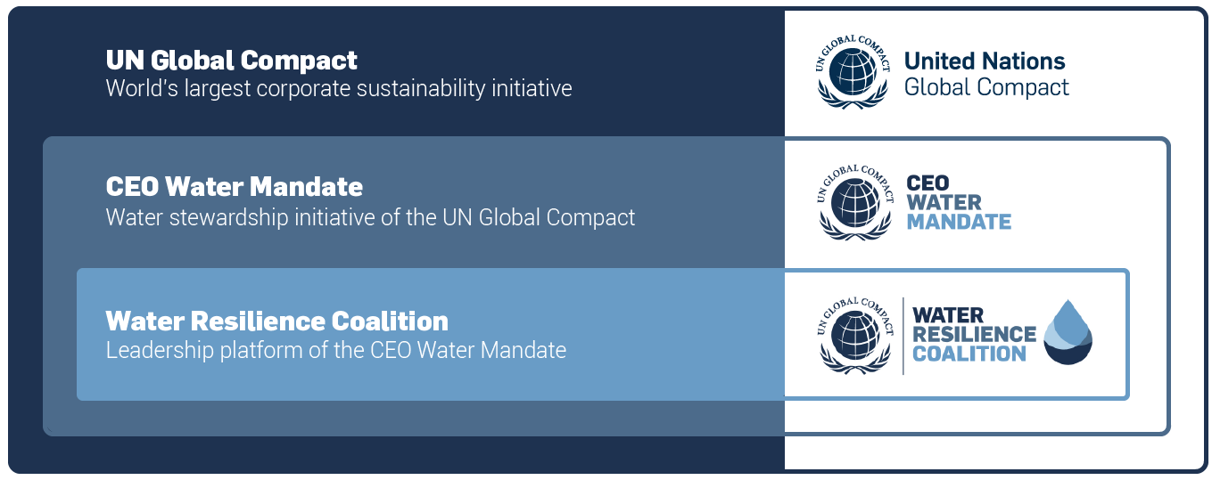
WASH4Work is the Water, Sanitation & Hygiene (WASH) Access initiative of the CEO Water Mandate
WASH4Work
Multi-stakeholder WASH Initiative hosted by CEO Water Mandate

Slide 7
WASH4Work supports pledge to
CEO Water Mandate 6 Commitments
Endorsers of the CEO Water Mandate commit to continuous progress against six core elements of stewardship and in so doing understand and manage their own water risks.
Direct Operations
Supply Chain & Watershed Management
Collective Action
Public Policy
Community Engagement
Transparency
Community Engagement
We pledge to undertake the following actions, where appropriate, over time:
Endeavor to understand the water and sanitation challenges in the communities where we operate and how our businesses impact those challenges.
Be active members of the local community, and encourage or provide support to local government, groups and initiatives seeking to advance the water and sanitation agendas.
Undertake water-resource education and awareness campaigns in partnership with local stakeholders.
Work with public authorities and their agents to support – when appropriate – the development of adequate water infrastructure, including water and sanitation delivery systems.
GLOBAL LEADERSHIP

Slide 8

WASH4Work supports
WASH Pledge Commitments
WASH Pledge commitment:
By signing the Pledge, companies commit to:
Implementing access to safe water, sanitation and hygiene at the workplace at an appropriate level of standard for all their employees in all premises under direct company control and within a time-frame of 3 years
Supporting partners across our value chains and communities that surround our workplaces
GLOBAL LEADERSHIP
The Pledge adheres to access to WASH as per WHO standards and international best practices.

Slide 9

WASH4Work supports
Water Action Hub
Global WASH projects added by companies and stakeholders as seen on the Water Action Hub interactive mapping tool.
https://wateractionhub.org

Slide 10
Member Benefits of the WASH4Work Initiative
  Companies are recognized for the actions they are taking to increase WASH access and contributions to SDG6 by being part of the WASH4Work Initiative
  Companies have direct access to leading practice on WASH access via corporate peers and WASH expert organization members
  WASH4Work supports companies in achieving their corporate water stewardship commitments to WASH access
GLOBAL LEADERSHIP

Slide 11
WASH4Work
A Business Led Multi-Stakeholder Initiative
MEMBERS & PARTERNS
11

Slide 12




Scaling up WASH Access is achievable through
Sharing knowledge and evolving leading practice
WASH4Work provides the platform for businesses to align on best practice, together with WASH experts; and to collectively advocate the business case for WASH to mobilise more business action on WASH as a priority in corporate water stewardship.
The opportunity of WASH4Work is to build on each other’s experiences and better define the co-benefits of prioritizing WASH and climate resilience, which includes women’s health, local economies, public health, sustainability and community resilience.
WASH4Work has an opportunity to amplify the women’s individual experiences, success stories and networks to demonstrate the power of collective action in communities. along the value chain.
WASH4Work brings together a wealth of knowledge of leading practice on achieving sustainable WASH access. With the support of the initiative WASH4Work members can make significant progress on WASH in our supply chains and in the communities where we operate.

Slide 13

Our Vision​
& Mission
WASH4Work is a multi-stakeholder initiative, launched in 2016, to mobilise business action on water, sanitation and hygiene (WASH) ​in workplace operations, in communities where companies operate, and across supply chains. ​
​
WASH4Work aims to: ​
Demonstrate business leadership on WASH in the workplace ​
Share knowledge, leading practice and advocate best-in-class standards ​
Continuously evolve the business case for prioritising WASH in corporate water stewardship ​
Connect members to scale up WASH impact ​
Build consensus and support the implementation of resilient WASH actions ​
Notes:
WASH4Work was launched on World Water Day 2016 with UNICEF as the champion of the initiative,
The goal of the initiative is to mobilize businesses to improve access to water, sanitation, and hygiene (WASH) in the workplace, across supply chains, and in the communities where workers live.
The initiative brings together businesses committing to WASH as a priority in corporate water stewardship with WASH expert stakeholders to advance business actions on WASH and to share leading practice to encourage more businesses to take action on WASH

Slide 14




Pillars of Our Work
LEARNINGS
2016- 2021
Notes:
WASH4Work was launched on World Water Day 2016 with UNICEF as the champion of the initiative,
The goal of the initiative is to mobilize businesses to improve access to water, sanitation, and hygiene (WASH) in the workplace, across supply chains, and in the communities where workers live.
The initiative brings together businesses committing to WASH as a priority in corporate water stewardship with WASH expert stakeholders to advance business actions on WASH and to share leading practice to encourage more businesses to take action on WASH

Slide 15



Current Projects
2022
Standardized Accounting Method for the Co-Benefits of WASH
Climate Resilient WASH Business Framework
Leading Practice on WASH in the Supply Chain
WASH Support for Suppliers
Notes:
WASH4Work was launched on World Water Day 2016 with UNICEF as the champion of the initiative,
The goal of the initiative is to mobilize businesses to improve access to water, sanitation, and hygiene (WASH) in the workplace, across supply chains, and in the communities where workers live.
The initiative brings together businesses committing to WASH as a priority in corporate water stewardship with WASH expert stakeholders to advance business actions on WASH and to share leading practice to encourage more businesses to take action on WASH

Slide 16
Standardized Accounting & Reporting Method for the Co-Benefits of WASH
WASH Impact Pathway

Slide 17
Climate-Resilient Water, Sanitation & Hygiene
(WASH) Business Framework
Going forward we join global and local stakeholders in developing and applying a climate-resilient WASH framework to our water, sanitation and hygiene access programs and investments.
The framework for action will include the following considerations:
Assessment of climate risk: Understanding the local context of climate change, water systems and water resources: Hazards, exposure, and vulnerability
Impacts of climate risks on WASH: Understanding the impacts of climate change on water, sanitation and hygiene access, services continuity and reliability
Preparedness and adaptation: Planning for the timely response to expected climate impacts and potential adaptation of water supply, sanitation and hygiene services
Solutions and implementation: Identifying opportunities to improve water, sanitation and hygiene services with climate-smart low carbon infrastructure, technologies, and capacity building in communities
Testing and monitoring: Identifying opportunities to continuously improve the continuity and reliability of services through benchmarking, evaluation, and validation
Reporting & disclosure: Contributing to advancements in leading practice by sharing learnings, findings, and impacts in collaboration with our stakeholders
Notes:
Co-Conveners:
WASH4Work, Water Resilience Coalition
Objectives:
Develop consensus on new targets for WASH best practice in corporate water stewardship that includes climate resilience.
Create a business specific framework and guidance on how to design and implement Resilient WASH strategies into water stewardship action plans - and integrate with global frameworks.
Create a database of practical solutions for developing and implementing Resilient WASH programming.
Produce a position paper outlining a Climate-Resilient WASH Framework for Business to present publicly during the COP27 Climate meetings in November 2022

Slide 18
WASH in the Supply Chain
Objectives:
- Define leading practice for implementation of WASH actions across supply / value chains
- Share learnings on supplier engagement & support mechanisms
- Develop support materials for suppliers’ WASH Pledge implementation journey.
Notes:
Opportunity:
- Develop best practice for engaging suppliers in WASH implementation
- Increasing impact of WASH via SMEs
Objectives:
- Define leading practice on how to implement WASH actions across supply chains
- Share learnings on how to engage suppliers via the WASH Pledge mechanism
- Develop support materials for suppliers’ WASH Pledge implementation journey.

Slide 19
Governance
Chair: Kate Holme, WaterAid
Vice-Chair: Michael Alexander, Diageo
Steering Group: CEO Water Mandate, Coca-Cola, Diageo, GAP Inc, Toilet Board Coalition, UNICEF, Unilever, WaterAid, WBCSD, Xylem
Secretariat: CEO Water Mandate
Notes:
As we have many new members and WASH Pledge signatories joining us today – we wanted to share the W4W governance structure and we will share with you a document outlining W4W’s governance following this meeting.

Slide 20
Membership Fee Structure
Corporate Members: $3,000.00/year
Note: For CEO Water Mandate endorsers this fee is allocated from the WASH pillar of the contribution you make each year to CWM. It is not an additional fee.
Suppliers: $1,000.00/year
Non-Corporate Partners: $1,500.00/year or equivalent in-kind support
Note: Contributions from the membership are structured to cover the costs of a lean Secretariat. Your participation to collective business action is most important, if fees are a barrier, please let us know !
Notes:
The W4W secretariat is funded via fees from each members to cover the costs of staffing, work program facilitation and communications and advocacy.
Invoices for 2022 will be sent in Dec 2021.

Slide 21



Contact us to Engage!
secretariat@wash4work.org
wash4work.org
@WASH4Work
/in/wash4work/

