Slide 1




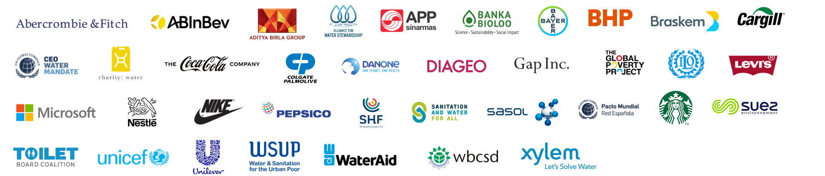
WASH in the Supply Chain
Leading Practice
November 2022
Notes:
WASH4Work was launched on World Water Day 2016 with UNICEF as the champion of the initiative,
The goal of the initiative is to mobilize businesses to improve access to water, sanitation, and hygiene (WASH) in the workplace, across supply chains, and in the communities where workers live.
The initiative brings together businesses committing to WASH as a priority in corporate water stewardship with WASH expert stakeholders to advance business actions on WASH and to share leading practice to encourage more businesses to take action on WASH

Slide 2


Our Vision​
& Mission
WASH4Work is a multi-stakeholder initiative, launched in 2016, to mobilise business action on water, sanitation and hygiene (WASH) ​in workplace operations, in communities where companies operate, and across supply chains. ​
​
WASH4Work aims to: ​
Demonstrate business leadership on WASH in the workplace ​
Share knowledge, leading practice and advocate best-in-class standards ​
Continuously evolve the business case for prioritising WASH in corporate water stewardship ​
Connect members to scale up WASH impact ​
Build consensus and support the implementation of resilient WASH actions ​
Notes:
WASH4Work was launched on World Water Day 2016 with UNICEF as the champion of the initiative,
The goal of the initiative is to mobilize businesses to improve access to water, sanitation, and hygiene (WASH) in the workplace, across supply chains, and in the communities where workers live.
The initiative brings together businesses committing to WASH as a priority in corporate water stewardship with WASH expert stakeholders to advance business actions on WASH and to share leading practice to encourage more businesses to take action on WASH

Slide 3




WASH in the
Supply Chain
AGENDA
WASH in the Supply Chain Working Group Objectives
Results of Member Consultation on Approaches to WASH in the Supply Chain
Support Tools for Suppliers
Examples of Leading Practice
Discussion & Perspectives: Towards a Collective Business Ambition
2023 Opportunities

Slide 4


WASH in the Supply Chain
Working Group 2022
Objectives:
- Define leading practice for implementation of WASH actions across supply / value chains
- Share learnings on supplier engagement & support mechanisms
- Develop support program and materials for suppliers’ WASH implementation journey.
Notes:
Opportunity:
- Develop best practice for engaging suppliers in WASH implementation
- Increasing impact of WASH via SMEs
Objectives:
- Define leading practice on how to implement WASH actions across supply chains
- Share learnings on how to engage suppliers via the WASH Pledge mechanism
- Develop support materials for suppliers’ WASH Pledge implementation journey.

Slide 5
Results of Member Consultation
Approaches to WASH in the Supply Chain / Value Chain
Leading Practice
Common Challenges
  WASH access requirement in supplier codes of conduct
  Incentives and support for Tier 1 suppliers
  Behavior change & Gender equity elements of WASH prioritized
  Development of specific WASH policies & solutions for agricultural and textile value chains
  Data on size of the gap in WASH access across full supply chains / value chains
  Standardized reporting on WASH actions and targets of suppliers
  Increasing expectations from sustainability reporting (DJSI, GRI, CDP, Ceres) on risk exposure linked to WASH in the supply chain
  Evolving climate and health risks disrupting WASH service resilience
GLOBAL LEADERSHIP

Slide 6
Water, Sanitation & Hygiene Access (WASH)
Supply Chain Risks
Safe WASH at work and at home directly affects worker health and safety, productivity and security of business-critical raw materials
Lack of access to WASH in supply chains, directly affects women, who are dominant in the workforces of agriculture and textile supply chains
Climate change is already disrupting the water cycle including WASH service continuity and resilience (UNICEF & WaterAid)
Price of WASH risk calculated at $6 Billion amongst just
10 global companies (CDP)

Slide 7
Water, Sanitation & Hygiene Access (WASH) Supply Chain Impact Opportunities
Universal WASH access will unlock trillions of dollars in value over the next 2 decades (WaterAid)
Access to WASH builds people’s resilience to climate change
via water security and capacity to manage water-related risks
(UNICEF & WaterAid)
Financial ROI of investing in WASH has been proven via productivity gains, avoided health costs, and contributions to shareholder value
(WaterAid)
4x Acceleration of WASH access services required to meet 2030 goals
(WHO/UNICEF JMP)

Slide 8
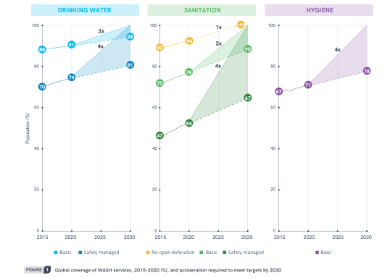
Water, Sanitation & Hygiene Access (WASH)
Size of the Global Gap (2020)
4x acceleration required to meet 2030 goals
WASH in the supply chain can support acceleration
Source: WHO/UNICEF JMP

Slide 9
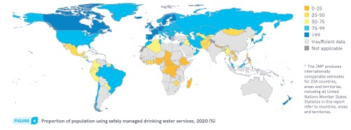
Water Access – Supply Chain Risk
Size of the Global Gap (2020)
Opportunity to overlay supply chain priority geographies with greatest need
Source: WHO/UNICEF JMP

Slide 10
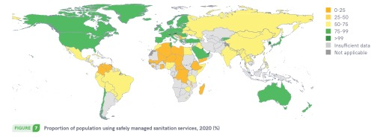
Sanitation Access – Supply Chain Risk
Size of the Global Gap (2020)
Source: WHO/UNICEF JMP

Slide 11
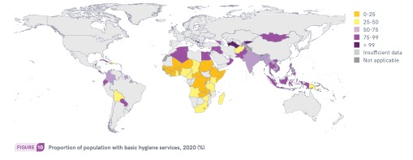
Hygiene Access – Supply Chain Risk
Size of the Global Gap (2020)
Source: WHO/UNICEF JMP

Slide 12
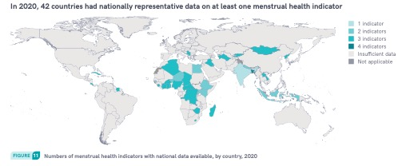
Menstrual Heath Access – Supply Chain Risk
Size of the Global Gap (2020)
Source: WHO/UNICEF JMP

Slide 13



WASH in the
Supply Chain
SUPPORT TOOLS
Water Action Hub – Mapping WASH Actions
WASH Pledge - Implementation Guidance
Standardized Accounting/Reporting for WASH
Climate-resilient WASH Business Framework

Slide 14
Mapping Supply Chain WASH Actions
Water Action Hub
Opportunity to link up supply chain actions for maximum impact
https://wateractionhub.org

Slide 15
WASH Implementation Support Tools for Suppliers
WASH Pledge Guidance & WaterAid Capacity Training
GLOBAL LEADERSHIP
Opportunity for suppliers to access leading practice support tools and networks

Slide 16
Standardized Accounting & Reporting Method for the Co-Benefits of WASH
Opportunity to capture consistent data on supplier WASH actions and impacts
WASH Impact Pathway

Slide 17
Climate-Resilient Water, Sanitation & Hygiene
(WASH) Business Framework
Going forward we join global and local stakeholders in developing and applying a climate-resilient WASH framework to our water, sanitation and hygiene access programs and investments.
The framework for action will include the following considerations:
Assessment of climate risk: Understanding the local context of climate change, water systems and water resources: Hazards, exposure, and vulnerability
Impacts of climate risks on WASH: Understanding the impacts of climate change on water, sanitation and hygiene access, services continuity and reliability
Preparedness and adaptation: Planning for the timely response to expected climate impacts and potential adaptation of water supply, sanitation and hygiene services
Solutions and implementation: Identifying opportunities to improve water, sanitation and hygiene services with climate-smart low carbon infrastructure, technologies, and capacity building in communities
Testing and monitoring: Identifying opportunities to continuously improve the continuity and reliability of services through benchmarking, evaluation, and validation
Reporting & disclosure: Contributing to advancements in leading practice by sharing learnings, findings, and impacts in collaboration with our stakeholders
Opportunity to build climate resilience into supply chain WASH requirements and guidance
Notes:
Co-Conveners:
WASH4Work, Water Resilience Coalition
Objectives:
Develop consensus on new targets for WASH best practice in corporate water stewardship that includes climate resilience.
Create a business specific framework and guidance on how to design and implement Resilient WASH strategies into water stewardship action plans - and integrate with global frameworks.
Create a database of practical solutions for developing and implementing Resilient WASH programming.
Produce a position paper outlining a Climate-Resilient WASH Framework for Business to present publicly during the COP27 Climate meetings in November 2022

Slide 18
WASH Pledge in the Supply Chain
Nov 2022
Addressing Safe water, sanitation and Hygiene in Xylem’s supply chain

Slide 19



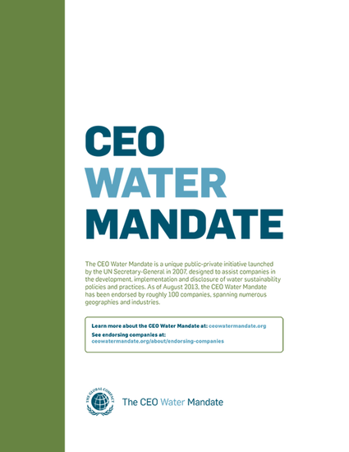
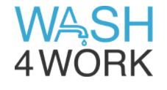
Xylem committed to champion Water Stewardship and WASH
Xylem is a signatory of the UN Global Compact, committed to taking action on the UN Sustainable Development Goals (SDGs)
Defining business commitments on Water Stewardship
Xylem is a signatory of the CEO Water Mandate since 2017, committed to taking a leadership role on water stewardship
Xylem is a steering committee member of WASH4WORK, a WASH Pledge signatory and committed to taking a leadership role on WASH withing our operations, communities and value chain
Defining business commitments on Water, Sanitation and Hygiene
Notes:
We need our suppliers to partner with us if we hope to fulfil our commitments and extend our impact

Slide 20
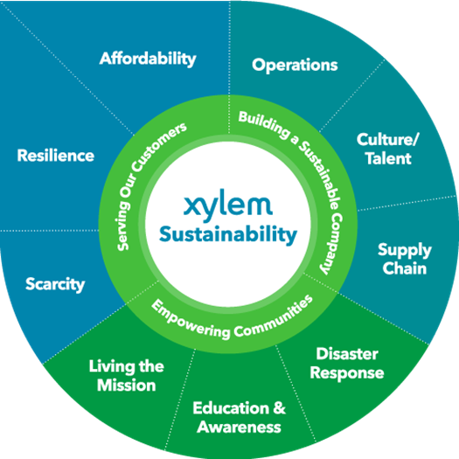



WASH Pledge in Xylem 2025 Sustainability Framework
Xylem Signed the WASH4WORK WASH Pledge in 2019
The WASH Pledge initiative has been embedded in our 2025 Sustainability Framework and Startegy, guiding our efforts on more than one of Xylem’s Signature Goals:
Based on company estimated, approximately 90 percent of Xylem revenue addresses SDG 6 – learn more here
WASH
FOR OUR EMPLOYEES
Ensure 100 percent of Xylem employees have access to clean water and safe sanitation at work, at home and during natural disasters
  Require suppliers to take the WASH Pledge for Access to Safe Water, Sanitation and Hygiene at the workplace
WASH
ACROSS OUR SUPPLY CHAIN
  Providing improved water and sanitation solutions to 20 million people at the base of the economic pyramid
  Provide 15 million people with water education to improve quality of life and raise awareness
WASH IN OUR COMMUNITIES
Notes:
SDG 6 Clean Water & Sanitation
• Xylem’s innovative solutions solve critical water issues for communities
around the world, including the millions of people living at the base of the
global economic pyramid. By developing and bringing to market digital
technologies in areas such as treatment, water loss and water reuse,
we benefit the public good by making communities more resilient and
sustainable. Our holistic watershed management practices create water,
energy and cost efficiencies that support health and well-being in those
communities that are in greatest need.
• Our corporate social responsibility programs, including Watermark, in
collaboration with its non-profit partners, work to make sanitation and
safe affordable drinking water accessible to all by restoring water-related
ecosystems and protecting them for future generations.
• We help our customers improve water quality by reducing pollution,
reducing the proportion of untreated wastewater and substantially
increasing recycling and safe water reuse globally.
• Based on company estimates, approximately 90 percent of Xylem revenue
addresses SDG 6.
This is why we are uniquely positioned to addressing WASH and SDG no. 6

Slide 21

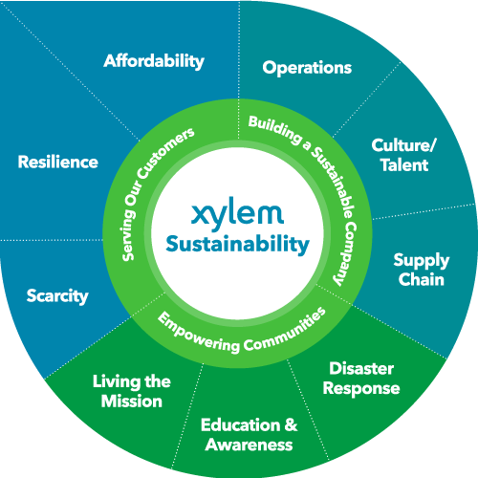

WASH as part of Building a Sustainable Supply Chain
Operations
Xylem Sustainability 2025 Framework
  2025 SUPPLY CHAIN SUSTAINABILITY GOALS
  Suppliers will disclose sustainability information via EcoVadis (or equivalent) system
Culture/
Talent
DRIVE
SUPPLIER CSR
Launched in 2020
REDUCE ENVIRONMENTAL IMPACT
  Suppliers will provide Scope 1 & 2 GHG emissions and water usage via CDP Supply Chain
Launched in 2021
Supply
Chain
  Engage Sustainability Critical suppliers in audit program and corrective action plans
MITIGATE SUSTAINABILITY RISK
Launching in 2022
  Implement a supplier diversity program in the US and increase diverse supplier spend
EMBRACE DIVERSITY
Launched in 2020
No Supplier can remain Preferred or Strategic to Xylem when they have not joined the WASH Pledge by 2025
COMMIT TO
SAFE WATER AND SANITATION FOR ALL
  Suppliers will take the WASH Pledge for the workplace
Launched in 2020

Slide 22
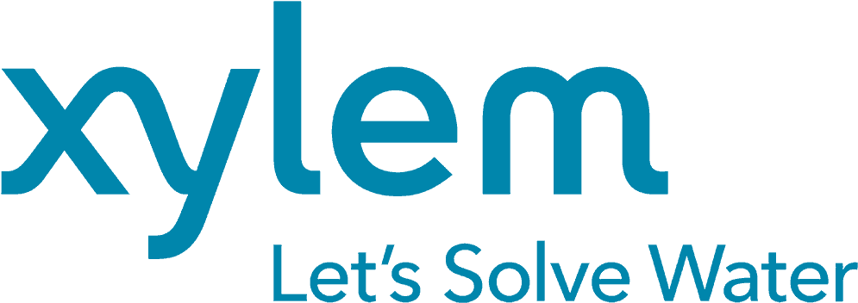
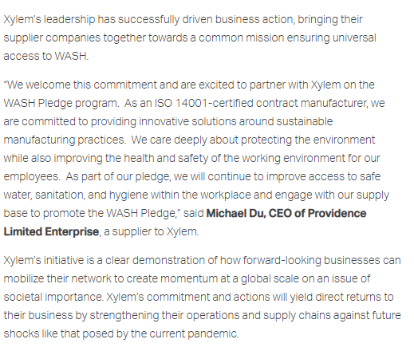
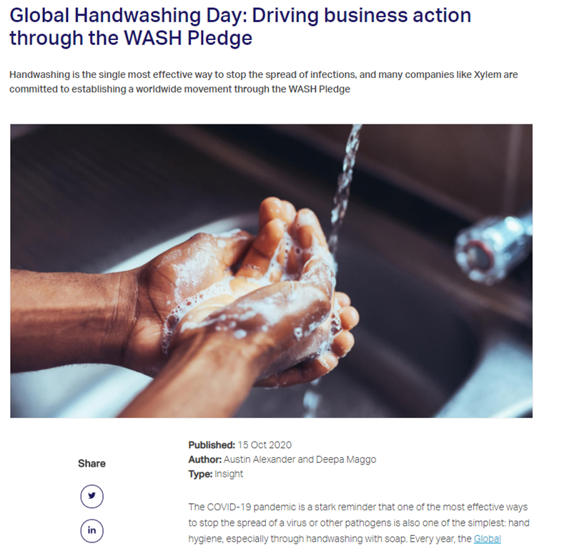
WASH Pledge Across Xylem’s Supply Chain
More than 500 Xylem Suppliers have joined the cause since January 2020!
Key Success Factors:
Key Learnings:
The WASH Pledge is relevant to any industry
Implementation of the WASH Pledge can vary in process
Governance & Communication are crucial to avoid double work
Our best partners will take pride in joining such an initiative
Education Opportunities for our suppliers
Targets & KPIs as % of spend to drive progress
Engagement Opportunities with Xylem & partners
One-on-One support & experience sharing

Slide 23
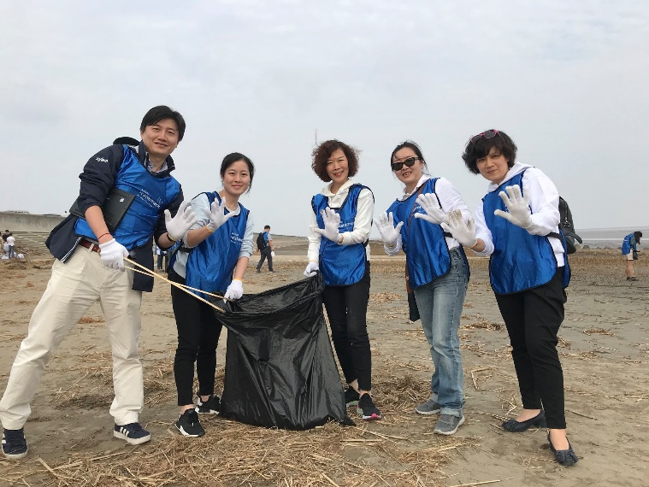
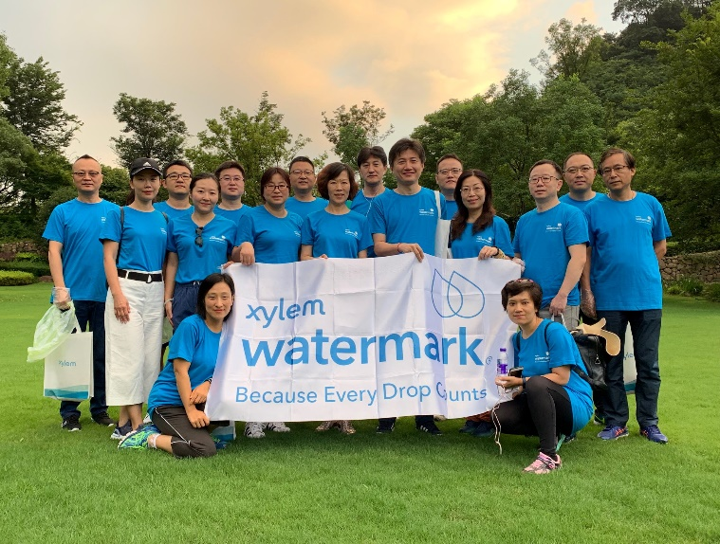
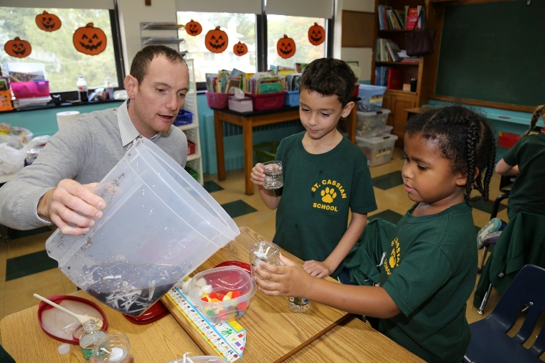
We can partner with you to Take Action in Your Community
Participate in global Watermark signature events, like the Month of Service
Leverage our suggested turn-key volunteer opportunities such as Plogging, Water Filter Builds, and Missing Maps
Plan collaborative events with your Xylem contacts
VOLUNTEER
    Apply for a Watermark Community Grant up to $10,000 for an NGO that you volunteer with on a water-related project
    Must meet criteria for volunteer time, # of people involved or # of people impacted through education or WASH access
COMMUNITY
GRANTS
    Via our Community Impact Portal, donate to 1:1 matching campaigns that advance our goals (access, education & disaster response)
    Raise funds with us to sponsor an AquaTower water filtration system, and send colleagues to volunteer on the project
RAISE FUNDS
https://www.xylem.com/en-bg/watermark/engage-with-us/
Notes:
We do not expect that all our suppliers take the same approach we have taken, of course.
So How can we help you have impact in your own communities and value chain?
Volunteer with us! Participate in global Watermark signature events, like the Month of Service Or Leverage our suggested turn-key volunteer opportunities such as Plogging, Water Filter Builds, and Missing Maps – these are all available by request or on our website
Plan collaborative events with your Xylem contacts – we would love to get out in the community alongside you and have employees with a lot of experience in planning activities.
If you have a project that you’d like to volunteer on which requires funding for the nonprofit involved, we encourage you to leverage our Community Grants program!
Apply for a Watermark Community Grant up to $10,000 for an NGO that you volunteer with on a water-related project
It must be aligned with our mission, and meet criteria for volunteer time, # of people involved or # of people impacted through education or WASH access. This is all outlined on our website as well.
And finally, if raising funds and making a donation is part of your strategy for making an impact, visit our Community Impact Portal, donate to 1:1 matching campaigns that advance our goals (access, education & disaster response)
You can also raise funds with us to sponsor an AquaTower water filtration system, and send colleagues to volunteer on the project.
Many ways to get involved, and we’d also love to hear your ideas and partner with you in your community. Any questions?

Slide 24
Thank You

Slide 25
WASH in the
Supply Chain
DISCUSSION / PERSPECTIVES
Current challenges to be overcome
Towards a Collective Business Ambition
How WASH4Work can support your WASH in the Supply Chain Goals
WASH Implementation support for suppliers

Slide 26
WASH in the
Supply Chain
OPPORTUNITIES 2023
- WORKING GROUP -
Mapping Collective Size of the Gap
Setting a Collective Business Ambition
Connecting Members to Collective Supplier Actions
Applying Climate-resilient WASH framework to supplier guidance
Applying Standardized Accounting /Reporting Method to measure progress
Notes:
WASH4Work was launched on World Water Day 2016 with UNICEF as the champion of the initiative,
The goal of the initiative is to mobilize businesses to improve access to water, sanitation, and hygiene (WASH) in the workplace, across supply chains, and in the communities where workers live.
The initiative brings together businesses committing to WASH as a priority in corporate water stewardship with WASH expert stakeholders to advance business actions on WASH and to share leading practice to encourage more businesses to take action on WASH

Slide 27



Contact us to Engage!
secretariat@wash4work.org
wash4work.org
@WASH4Work
/in/wash4work/

