Slide 1

The Road Ahead: Innovative Tools and Collaborations to Further Supply Chain Action
Jason Morrison
Stockholm World Water Week
September 3rd, 2014

Slide 2

Why the Water Action Hub?
  The complexity of engaging stakeholders on local water issues make water risk management a challenging task for individual organizations
  It is generally accepted that companies need to collaborate with each other, NGOs, development agencies, and governments to effectively address many water risks
  Larger alliances with pooled resources and focused efforts in shared “hotspot” watersheds would be more effective than optimistic approach to collective action.
  Provides water stakeholders insight into on-going water initiatives and contacts in various regions, resulting in increased potential for synergy and collective action
  Identify and engage with potential partners and initiatives in regions of key mutual strategic interest
  Work on the Water Action Hub is made possible by the support of
  Deloitte, GIZ, The Coca-Cola Company, SABMiller, Reed Elsevier, Veolia Water North America, UNEP, and the members of the Advisory Committee who have agreed to give their time

Slide 3
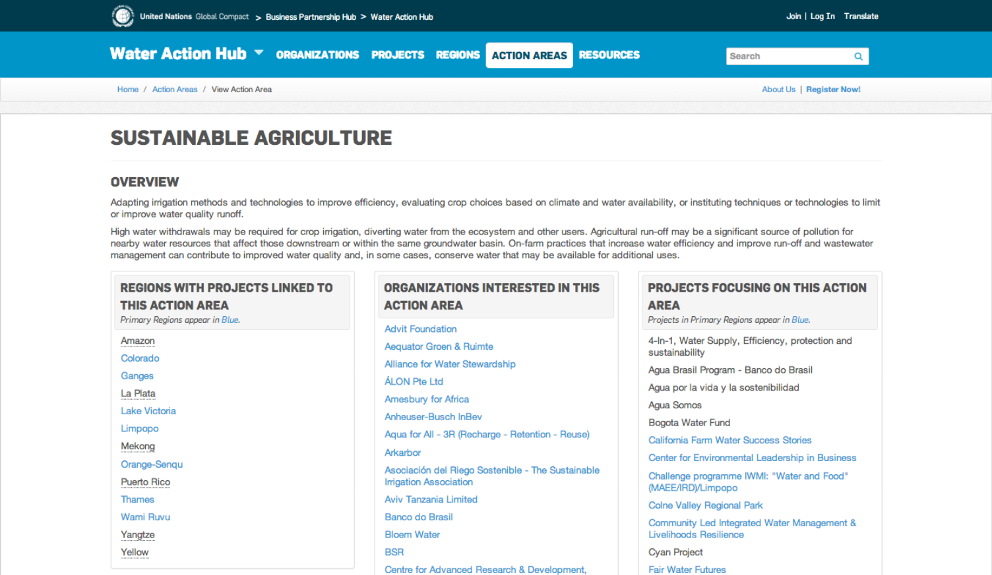
Sustainable Agriculture Action Area

Slide 4
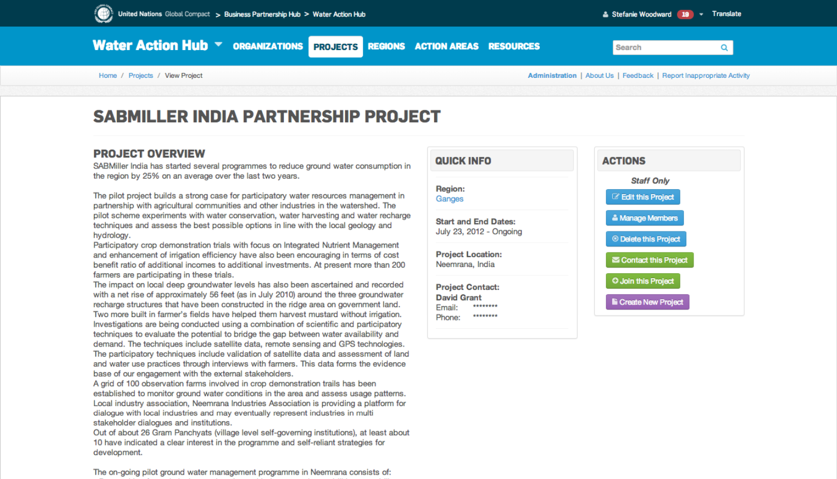
Sustainable Agriculture Action Area
Notes:
https://wateractionhub.org/projects/view/15/

Slide 5
Sustainable Agriculture Portal Objectives
Enable more effective communication, coordination action, and collaboration to address key water-related agricultural challenges
Increase collective action across industry sectors, and with suppliers, governments, and civil society
Upscale existing partnerships and increase impacts by engaging a critical mass of actors
Enable a coordinated and leveraged corporate water stewardship interventions to address water challenges in key agricultural regions
Notes:
the Hub will develop a specialized portal that will enable companies to collaborate with their peers, suppliers, governments, and civil society to more efficiently coordinate with one another across the globe to address agriculture related water challenges and up-scale solutions. Oriented around the Hub’s current “Sustainable Agriculture” action area (one of twelve such action areas featured on the platform), the portal will help organizations to pursue collective action with global actors or to highlight on-going basin-level projects on specific issues related to sustainable agriculture, such as promoting on-farm water efficiency practices, implementing better effluent management measures, or working to improve local governance around water and agriculture. To start, the portal will focus on a few select high-priority agricultural growing regions and commodities common to a number of key industry sectors. Similar to the current architecture of the Hub, the “Sustainable Agriculture” portal will enable organizations to filter across interlinked information sets to find potential partners. By doing so, the Hub will help fulfil the following objectives:
To enable more effective coordination, collaboration, and action to address water-related challenges in the agricultural sector to promote more sustainable practices.
To scale up existing partnerships and increase impacts in the food and beverage industry and across other industries by aligning similar efforts and sharing and building on best practices in key regions, watersheds, and commodities.
To raise awareness about corporate water stewardship with a wider range of related stakeholders in key regions of interest.

Slide 6
Geographic Priorities
  Guanajuato Province, Mexico
  United States: Mississippi River Basin, San Joaquin Valley
  China
  India: Maharashtra, Andhra Pradesh
  Guadalquivir Basin, Spain
  Germany
  Uganda
  Colombia
  Brazil
  Peru
  Australia
  Vietnam

Slide 7
Partnership and Outreach
Tier 1
Sustainable Agriculture Initiative / Sustainable Food Lab
Tier 2
NGO partners: Solidaridad, WWF, others
Standards systems: Bonsucro, AWS, Fair Trade
Better Cotton Initiative
US Environmental Protection Agency
Sustainability Consortium
European Water Partnership
UN PRI
Notes:
The development of the “Sustainable Agriculture” portal will involve extensive outreach. Outreach will be made to key international, regional, and national level organizations involved in sustainable agriculture initiatives, particularly those with a private sector engagement and/or water focus. Engaging these organizations will enable the specialized portal to adequately align with and include efforts already underway and be designed in a way that meets the strategic and practical needs of potential users.
There will also be outreach to key organizations and potential partners (e.g. local companies/businesses, civil society, and government agencies) not yet aware of or involved in agriculture-related water stewardship to learn about what stewardship entails and how to take action. This would occur in identified basins and geographies in order to foster dialogue and real on-the-ground collective action.

Slide 8
Partnership with SAI/SFL
The Mandate is working with SAI Platform and SFL in the design of the Sustainable Agriculture Portal to ensure that its functionalities will complement the SAI/SFL initiative and be useful to members/endorsers of all three organizations
Working across initiatives to identify priority regions and/or commodities to focus joint efforts
Capturing SAI/SFL projects in the SusAg Portal
Joint outreach efforts to stakeholders, members and endorsers

Slide 9
Partnership with US EPA
Mississippi River Basin will be added to the Water Action Hub to support the EPA’s Agency’s Mississippi River and Gulf of Mexico Watershed Nutrient Task Force (Hypoxia Task Force)
Utilizing the Hub as a “rallying vehicle” to engage the private sector, US EPA, State and Municipal agencies, research institutes and NGOs to address the nutrient issues in the Mississippi
Outreach and engagement to suppliers / growers in the upper Mississippi river basin

Slide 10
Sustainable Agriculture Action Areas
Pesticide and Fertilizer Management: Agricultural runoff of pesticides and fertilizers can pose significant environmental and human health risks to downstream water users through pollution of surface and groundwater.
Operational Efficiency: minimizing the amount of water diverted to irrigate crops that is not used directly by the plants, through improved irrigation technology or using Conservation Agriculture to improve yields while decreasing water withdrawals.
Agricultural Sustainability Metrics, Measurement and Evaluation: Synchronization of reporting practices and measures to help companies and growers work together to improve water stewardship practices throughout the supply chain

Slide 11
Sustainable Agriculture Action Areas
Ground Water: Threats to the sustainability of water supply from ground water overdraft salinization of aquifers and land subsidence.
Soil Erosion and Health: Erosion and soil degradation can threaten the long­-term viability of agricultural systems and lead to sedimentation of freshwater and marine environments.
Dairy and Livestock: Manure runoff from dairy farms and Concentrated Animal Feeding Operations, as well as the quantity of water consumed by these operations, can have significant impacts on local waterways.

Slide 12
Existing Action Areas on the Sustainable Agriculture Portal
Climate Change Adaptation and Resilience: Climate change increases water risks, such as water scarcity, pollution, competition, and impacts on water infrastructure.
Public Awareness and Education: Raising awareness can contribute to more efficient use of water resources, protection of aquatic ecosystems, the development of effective environmental and water standards.
Ecosystem / Sourcewater Protection / Restoration: The degradation of aquatic ecosystems and natural resources within a catchment impacts biodiversity, hydrological flow, environmental water requirements, water quality, and the ability to use natural resources.
Monitoring and Knowledge Sharing: Effective water management in agricultural and industrial systems requires robust data, monitoring systems, and analytics.

Slide 13
Plans Going Forward
Q3 2014 Water Action Hub Portals Design
Q4 2014 Launch Apparel and Sustainable Agriculture Portals
Q4 2015 - 2015
Outreach and regional Expansion
Local Face-to-Face Facilitation
Technical Upgrades and Amendments as Needed
Notes:
We pitched a couple of things for monitoring and assessment:
The first will involve a technical approach and will build in some additional administrative tools to monitor how connections are being made. This could include the development of a system to visually depict messages being sent between organizations to understand who is being contacted. We will do some research to other similar initiatives to understand what technical mechanisms they have in place to monitor connections being made that take into account user’s privacy concerns.
Survey of all current Hub users in early 2014 to understand how they are using the Hub and who they have connected with.
These two approaches will allow the project team to assess how well connections are being formed on the Hub and where improvements will need to be made.
Both tracks would allow us to better understand if projects are actually being formed and to assess what other technical changes/amendments need to be made for the Hub to be more effective.

Slide 14
Reflections from the day

